Slide 1



ECE 445 Potential Project Spring 2024
John M. Hart
Principal Research Engineer
Manager and Coordinator of the
CfA Shared Robotics Laboratories

Slide 2
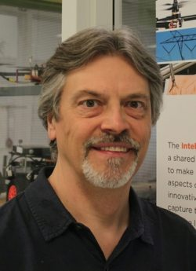
Center for Autonomy Manager and Laboratory Coordinator
Design Lab Spaces and Coordinate Day-to-day Operations
Principal Research Engineer with over two decades of interdisciplinary research experience at the Coordinated Science Laboratory and Beckman Institute
Co-PI on research projects collaborating with various engineering, biology, and agriculture professors
Developed biomimetic robots, machine vision inspection systems, custom WFOV cameras, wireless sensor systems, etc
Mentored and guided over 150 graduate and undergraduate students on research projects (including ECE 445)
Please feel free to contact me with questions (jmhart3 @ illinos.edu)
John M. Hart
UIUC ECE Graduate

Slide 3

CfA Shared Robotics Laboratories
The Intelligent Robots Lab was established in 2015 through an initiative of the Coordinated Science Laboratory
The facilities enable cutting-edge robotics research for our robotics community at the University of Illinois Urbana-Champaign
Labs are now an integral part of the Center for Autonomy
Coordinated Science Laboratory

Slide 4
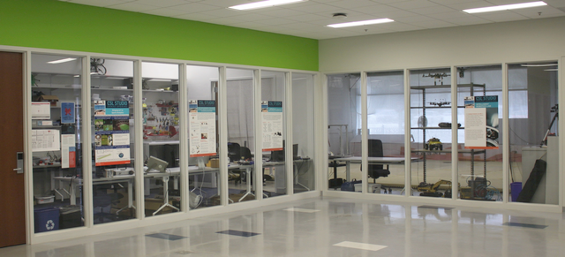
Intelligent Robotics Lab Focus
In this innovative lab researchers seek to make breakthroughs in key aspects of Mobile Robotics
Projects are focused mainly on the challenges of Autonomy, Control and Artificial Intelligence
Robot Builders Room and Flying Arena

Slide 5
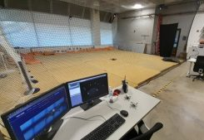
IRL: Flying Arena
Experimental space, ~1000 sq.ft. (13 ft. high), for aerial and ground robot research
Vicon motion capture system with millimeter position accuracy
Realtime position feedback streamed via WiFi to Matlab, ROS or custom software
Indoor Flying Arena

Slide 6
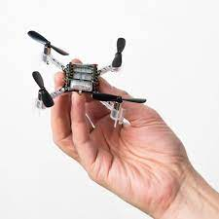
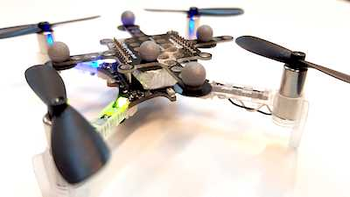
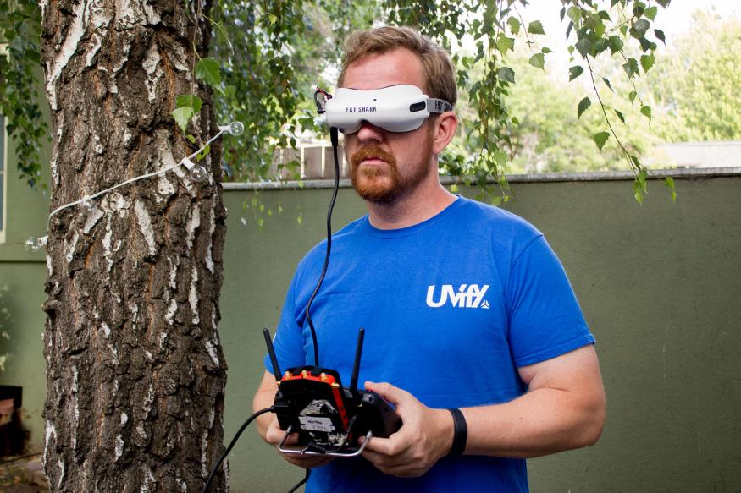
Potential Project for ECE445 Group
Design a First Person View (FPV) Racing Drone using a CrazyFlie Quadcopter
FPV Allows the Pilot to See Through a Camera Mounted on the Drone for Racing
Design a Very Small FPV System for Flying using a CrazyFlie Quadcopter
Need very small light weight camera and transmitter – payload is very limited
Build a PCB Using IR LED Markers with Programmable Configurations
Develop on board software to configure the LED patterns
Learn the Vicon motion capture system to recognize different Marker configurations on drones and track their position

Slide 7
Please Contact Me With Any Questions
John M. Hart
Principal Research Engineer
Coordinated Science Laboratory and
Center for Autonomy
jmhart3 @ illinois.edu

